Slide 1


Build an API with Firebase
Jr Jean Sekpon
Senior Software Engineer

Slide 2
Agenda
What is an API?
What is HTTP?
What is a RESTful service?
What is Firebase?
Sample Project
Next Steps

Slide 3
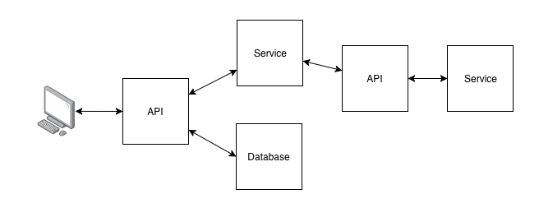
What is an API?
Application Programming Interface (API) is a set of functions classes and methods that serve as interface through which software provides services to other software - Wikipedia
(translation) how software systems communicate

Slide 4
What is HTTP?
HTTP = Hyper Text Transfer Protocol
Protocol used by web technologies and browsers to communicate
Common Verbs:
  GET = retrieving data
  POST = creating or updating data
  PUT = updating data
  DELETE = deleting data

Slide 5
HTTP Verbs
CRUD = Create, Read, Update, Delete
POST | Create Operation, typically has an associated body
GET | Read Operation, typically has no body
PUT | Update Operation, typically has an associated body
DELETE | Delete Operation, typically has no body

Slide 6
What is a RESTful Service?
REST refers to Representational State Transfer,
Leverages HTTP Methods and W3C standards
Define REST in terms of Requests
Requests consist of:
  HTTP Verbs
  Headers
  Request Parameters
  Request Body
APIs contain RESTful Services that use the HTTP Protocol
to send and receive requests

Slide 7
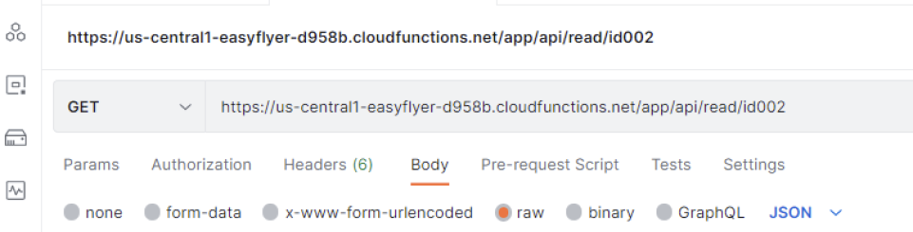
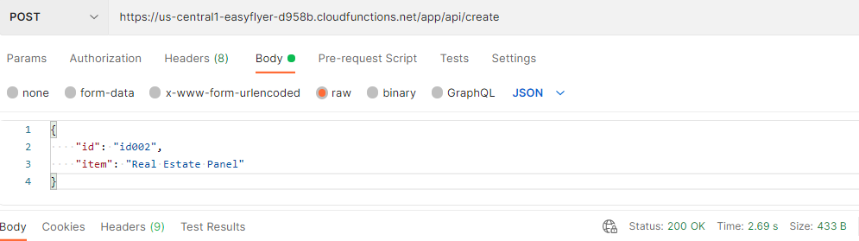
REST Request
Example GET Request:
Example POST Request

Slide 8
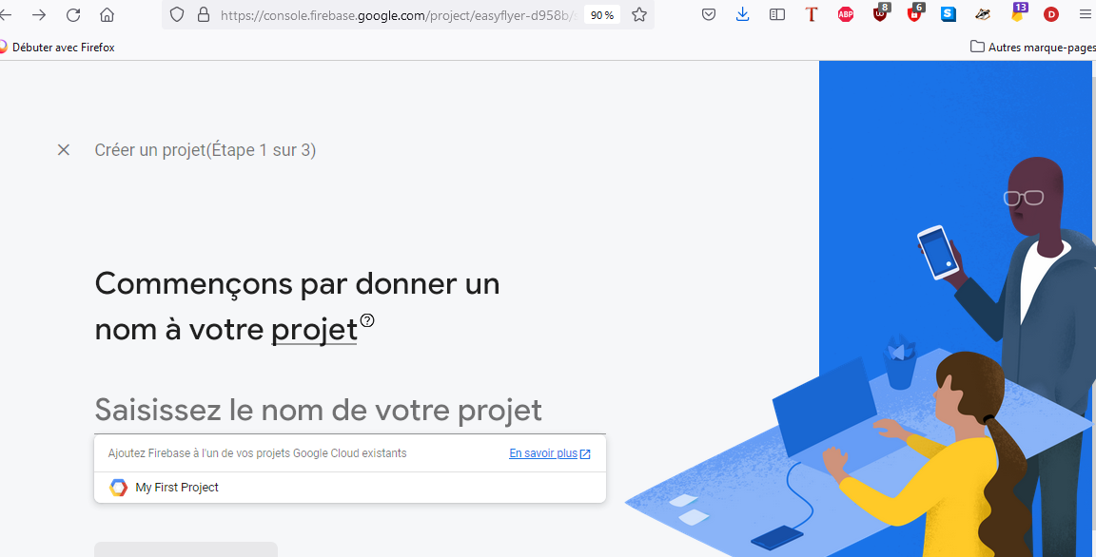
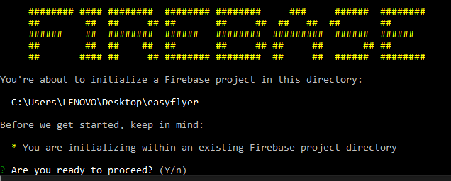
Firebase
Google Developer Mobile Platform
Free
Fun
Easy to Use
Pre-provisioned environment for developers to get up and running fast
Firebase CLI, (Gmail Account)

Slide 9
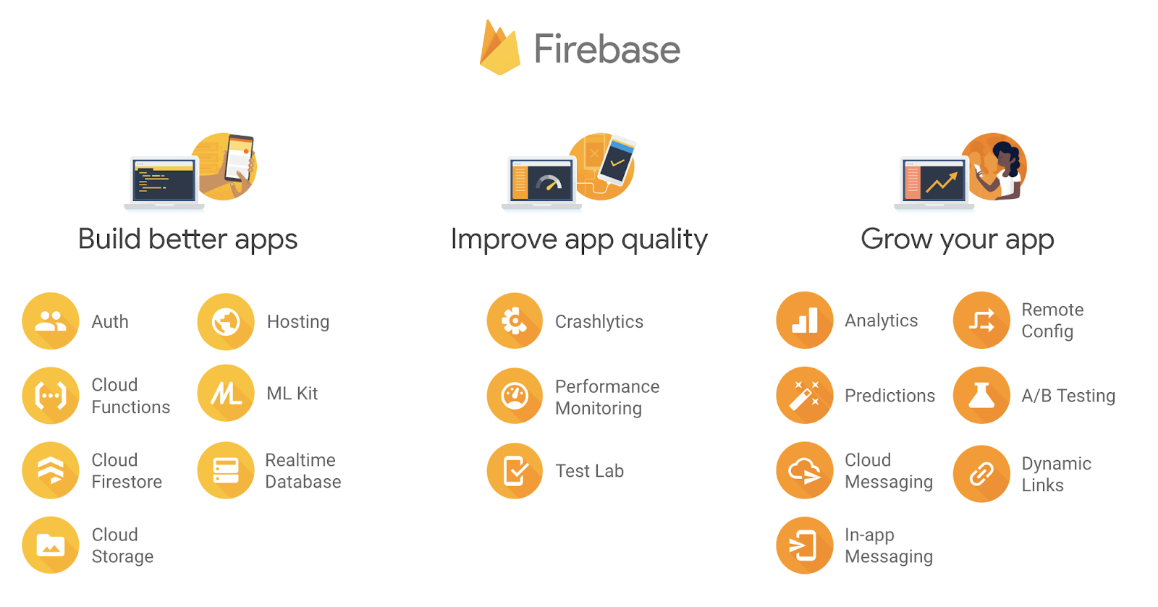
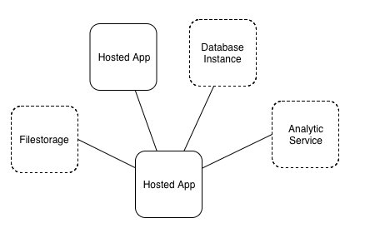
Firebase

Slide 10





Building an API with Firebase
Firebase Cloud Functions
Express
Node.js
NPM
Angular
Postman

Slide 11
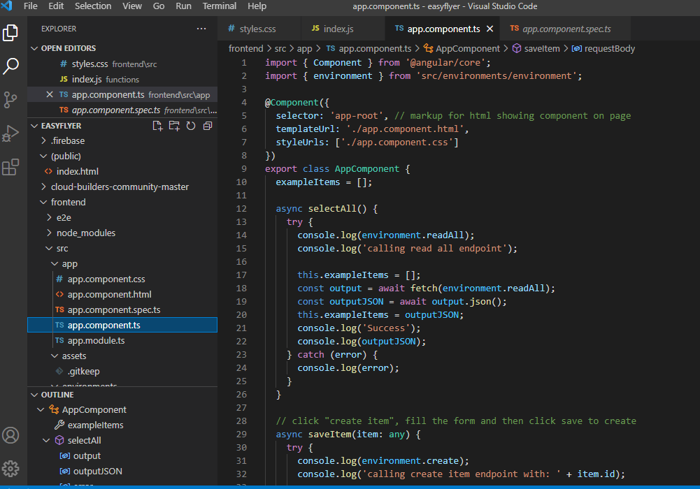
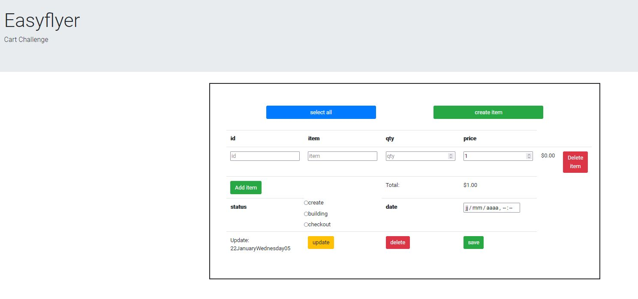
Example

Slide 12
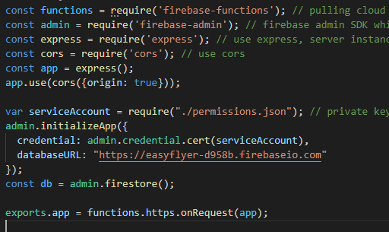
API Packages and Express
firebase-functions enables you to create functions
firebase-admin is the firebase admin SDK that connects your app to Firebase
express creates a Node server instance
cors is an npm module that allows your functions to run somewhere separate from your client. The app.use enables cors.

Slide 13
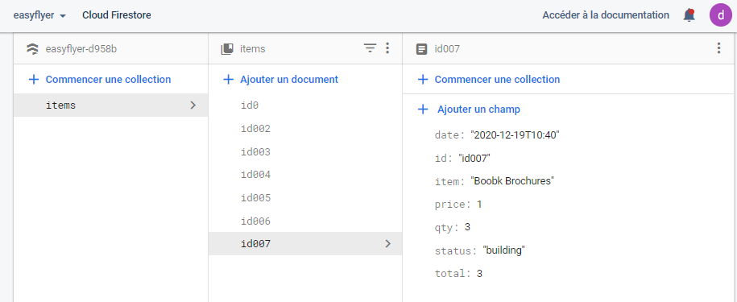
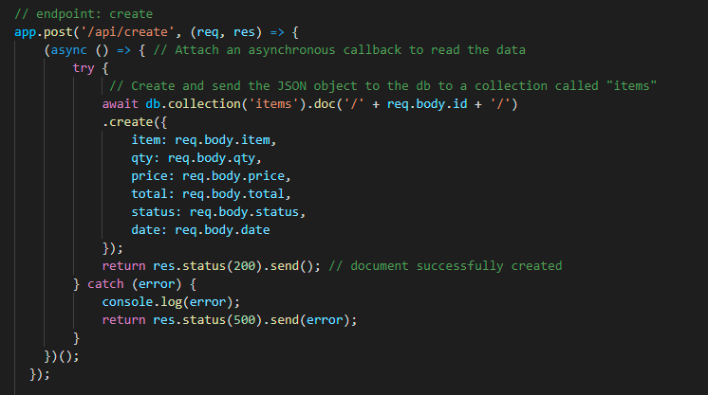
Database Calls

Slide 14
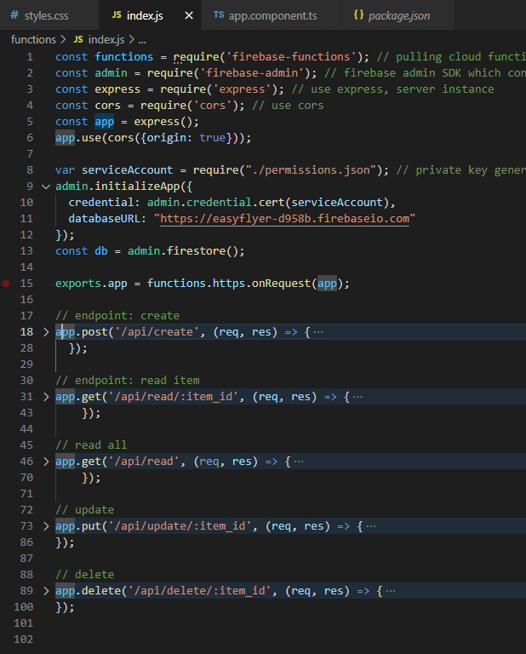
Endpoints
/create
  (C) create item
/read-item/:item_id
  (R) read a specific item (by ID)
/read-items
  (R) read all items (total collection)
/update-item/:item_id
  (U) update an item
delete-item/:item_id
  (D) delete an item
Create, Read, Update, Delete = CRUD

Slide 15
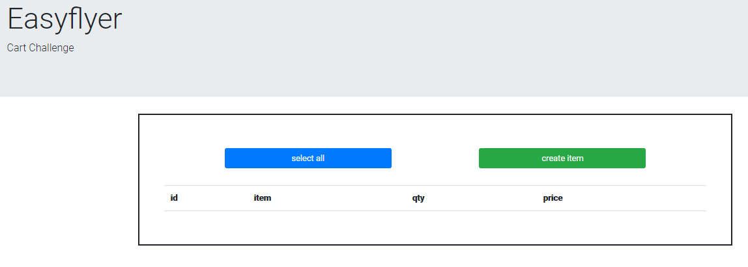
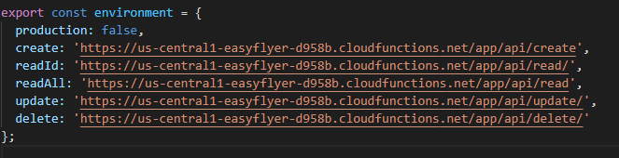
Frontend: Angular

Slide 16
Next Steps
Features
Improvements

Slide 17
Thank you!

